Slide 1

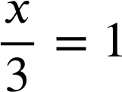
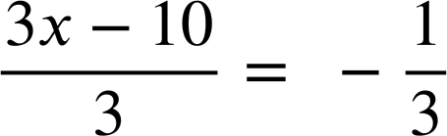
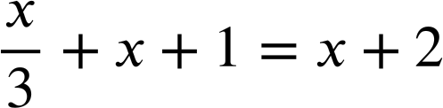
Many equations, one solution
Task A: Maintaining equality while manipulating equations
Complete the equations in this diagram. The arrows show the operation that is being applied to the whole equation.
5(x + 4)− 4 = 31
x + 1 = 4
+(−4)
+ (−5x)
5(x + 4) = 35
6x + 1 = 4 + 5x
+ 1
× 5
6x = 3 + 5x
x + 4 = 7
+ 5x
+ 4
x = 3
× 3
×
3x = 9
+(−10)
3x − 10 = −1
+ (x + 1)
÷ 3

Slide 2
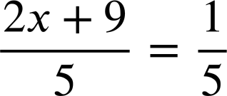

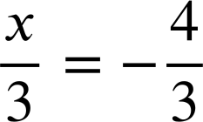
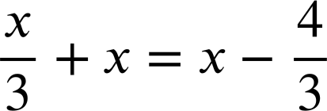
Many equations, one solution
Task B: Generating equations with the same solution
Fill in the missing expressions and operations in this diagram.
6 = 2 − x
×
+ (−x)
2x + 9 = 1
x + 6 = 2
+ 9
+ (−4)
2x = − 8
x + 10 = 6
× 2
+ 10
x = − 4
+ 3x
4x = 3x − 4
×
+ 4x
8x = 7x − 4
+ x
+ 4
8x + 4 = 7x
Mathematics in Education and Industry
v2.3

